Slide 1


Slide 2
OPTICS stands for Ordering Points To Identify Cluster Structure. The OPTICS algorithm draws inspiration from the DBSCAN clustering algorithm. The difference ‘is DBSCAN algorithm assumes the density of the clusters as constant, whereas the OPTICS algorithm allows a varying density of the clusters.
OPTICS adds two more terms to the concept of the DBSCAN algorithm, i.e.:
1.Core Distance
2.Reachability Distance

Slide 3
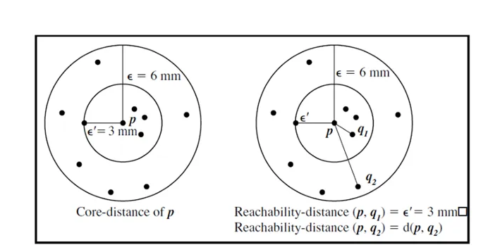

Slide 4
